Slide 1
Lecture 5
ADT and Big-O Notation

Slide 2
Main Points
Understand ADT
Calculate the growth rate of an algorithm
Exercises

Slide 3
Abstract Data Types
The concept of abstraction means:
  You know what a data type can do
  How it is done is hidden
An Abstract Data Type ( ADT ) is a programming tool that helps us store, manipulate, and retrieve data, in a way that captures some attributes of a real-world situation.
  We will be using data structures for implementing an ADT.

Slide 4
ADT Design:
After identifying which data to use
What operations/function you want to do with data:
  insert an item,
  delete an item,
  iterate through all the items,
  search for an item,
  sort the items
  …

Slide 5
ADT (Continue..)
ADT
  Declaration of data
  Declaration of operations
  Encapsulation of data an operations
Students  array of structures (an implementation)
Car  structure (id, driver, trade…) (an implementation)
For any given implementation:
  The data we are dealing with are of some Data Types
  A construct to store the data type: Data Structures
  The set of operations on the data types defined in (1).
 (1) & (3) ➔ Abstract Data Type
 (2) ➔ a way to implement the ADT

Slide 6

  The purpose of this course is to discuss
  different ADTs along with associated
  operations and Data Structures

Slide 7
ADT: Examples
Linked / linear List
Stacks
Queues

Slide 8
Linked List
Element 1
Element 2
Element 3
Delete a Node: Element 3
Element 1
Element 2
Insert a Node: Element N
Element 1
Element 2
Element N

Slide 9

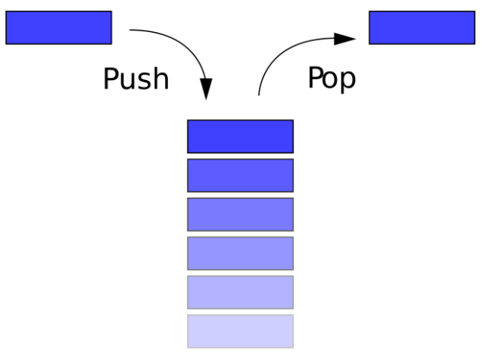
Stacks: Representation

Slide 10
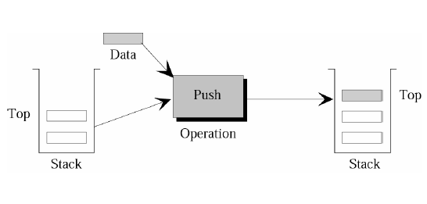
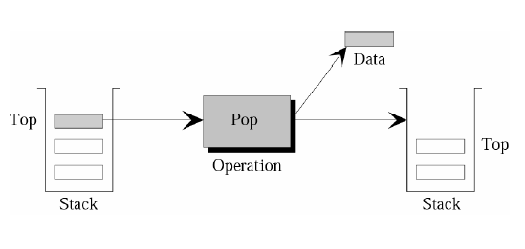
Stack: Pop and Push Functions
Push:
Pop:

Slide 11

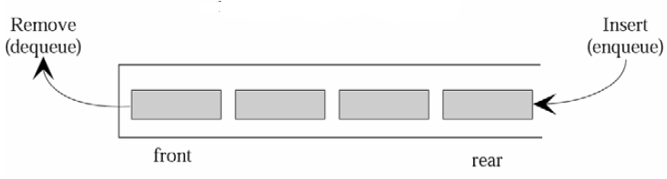
Queues: Representation

Slide 12
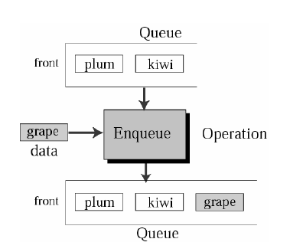
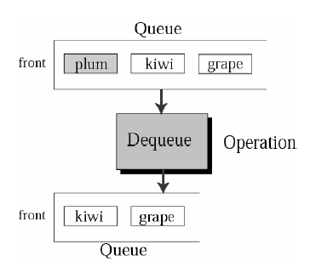
Queue: Enqueue & Dequeue operations
Enqueue: Dequeue:

Slide 13
Conclusion
An abstract data type= a user defined data type + set of basic operations  This allows one truly to see the type as a unified concept

Slide 14
Algorithm Efficiency and Big-O Notation

Slide 15
Executing time
Suppose that two algorithms are performing the same task such as search (linear search vs binary search) or sorting (selection sort vs insertion sort). Which one is better?
  One possible approach to answer this question is to implement these algorithms and run the programs to get execution time.
    A problem!!

Slide 16
Growth Rate
It is very difficult to compare algorithms by measuring their execution time. To overcome these problems, a theoretical approach was developed to analyze algorithms independent of computers and specific input. This approach approximates the effect of a change on the size of the input. In this way, you can see how fast an algorithm’s execution time increases as the input size increases, so you can compare two algorithms by examining their growth rates.

Slide 17
Watch this video
https://www.youtube.com/watch?v=V6mKVRU1evU

Slide 18
Big O Notation
Consider linear search:
  Algorithm
  How many comparisons required?
  What about if we double the size of the array?
  Algorithm grows at a linear rate
  O(N)

Slide 19
Big O Notation
Some Rules:
1. Ignoring Multiplicative Constants
  The linear search algorithm requires n comparisons in the worst-case and n/2 comparisons in the average-case. Using the Big O notation, both cases require O(n) time. The multiplicative constant (1/2) can be omitted. Algorithm analysis is focused on growth rate. The multiplicative constants have no impact on growth rates. The growth rate for n/2 or 100n is the same as n, i.e., O(n) = O(n/2) = O(100n).

Slide 20
Rule to respect
2. Ignoring Non-Dominating Terms
  Consider finding the max in an array n
  It take 1 comparison when n is 2, 2 comparisons when n is 3, n-1 comparison when the size is n.
  Algorithm analysis is for large input size. If the input size is small, there is no significance to estimate an algorithm’s efficiency
  Growth of this algorithm is of ?

Slide 21
Constant Time
The Big O notation estimates the execution time of an algorithm in relation to the input size. If the time is not related to the input size, the algorithm is said to take constant time with the notation O(1).
  The process of getting an element from an array is of constant time: it does not grow as the size of the array increases

Slide 22
Big O Rules
The Sum rule:
  IF T(n) = T₁(n) + T₂(n)
  THEN T(n) = O(max(T₁(n), T₂(n))
  Exp: T(n) = n³ + n² = O(n³)
The Product rule:
  IF T(n) = T₁(n) * T₂(n)
  THEN T(n) = O(T₁(n) * T₂(n))
  Exp: T(n) = n³ * n² = O(n⁵)
The Scalar rule:
  IF T(n) = K * T₁(n)
  THEN T(n) = O(T₁(n))
  Exp: T(n) = 7 * n³ = O(n³)

Slide 23
Hints for Calculating the time complexity
Comments: No Time
Declaration: No Time
Expressions & Assignments: 1 Time Unit
Iterations: the number of iterations times the time of included statements
Selections: Condition + The worst case

Slide 24
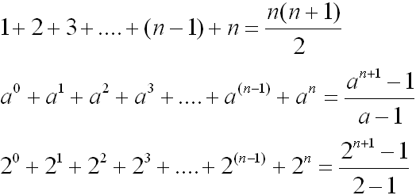
Important Formula to Remember

Slide 25
Calculate the time complexity for the following loops
Simple loop
for(i=1; i<=n;i++)
k=k+5;
Time Complexity:
T(n)=c*n  ignore c O(n)
Nested loops
for (i = 1; i <= n; i++) {
for (j = 1; j <= n; j++) {
k = k + i + j;
}
}
Time Complexity?

Slide 26
Repetition: Calculate the time complexity for the following loops
Nested loops
  for (i = 1; i <= n; i++) {
  for (j = 1; j <= 20; j++) {
  k = k + i + j;
  }}
Sequence
for (j = 1; j <= 10; j++)
k = k + 4;
for (i = 1; i <= n; i++) {
for (j = 1; j <= 20; j++) {
k = k + i + j;
}
}

Slide 27
Selection
if (condition) {
sequence of statements 1 }
else {
sequence of statements 2
}
 One of the sequences will be executed: take the max(time(sequence1),time(sequence 2))

Slide 28
Growth Rates
Seven functions g(n) that occur frequently in the analysis of algorithms (in order of increasing rate of growth relative to n):
  Constant ≈ 1
  Logarithmic ≈ log n
  Linear ≈ n
  Log Linear ≈ n log n
  Quadratic ≈ n²
  Cubic ≈ n³
  Exponential ≈ 2^{n}

Slide 29
Growth Rate: Comparison
 | n=1 | n=2 | n=4 | n=8 | n=16 | n=32
1 | 1 | 1 | 1 | 1 | 1 | 1
logn | 0 | 1 | 2 | 3 | 4 | 5
n | 1 | 2 | 4 | 8 | 16 | 32
nlogn | 0 | 2 | 8 | 24 | 64 | 160
n² | 1 | 4 | 16 | 64 | 256 | 1024
n³ | 1 | 8 | 64 | 512 | 4096 | 32768
2^{n} | 2 | 4 | 16 | 256 | 65536 | 4294967296

Slide 30
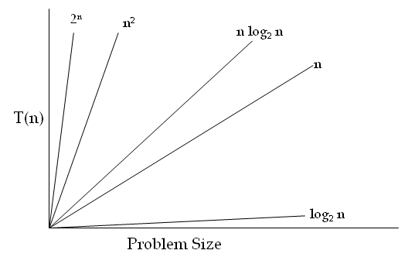
Important graph to remember

